Slide 1
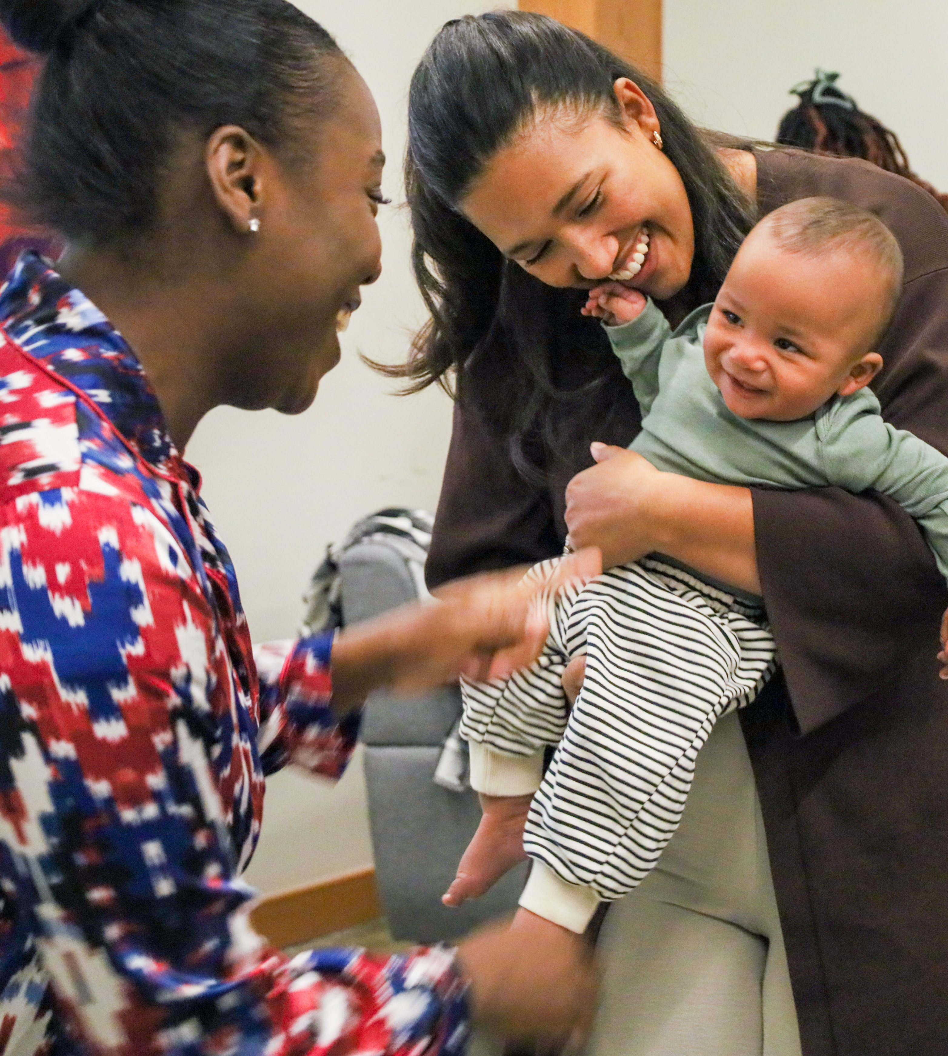


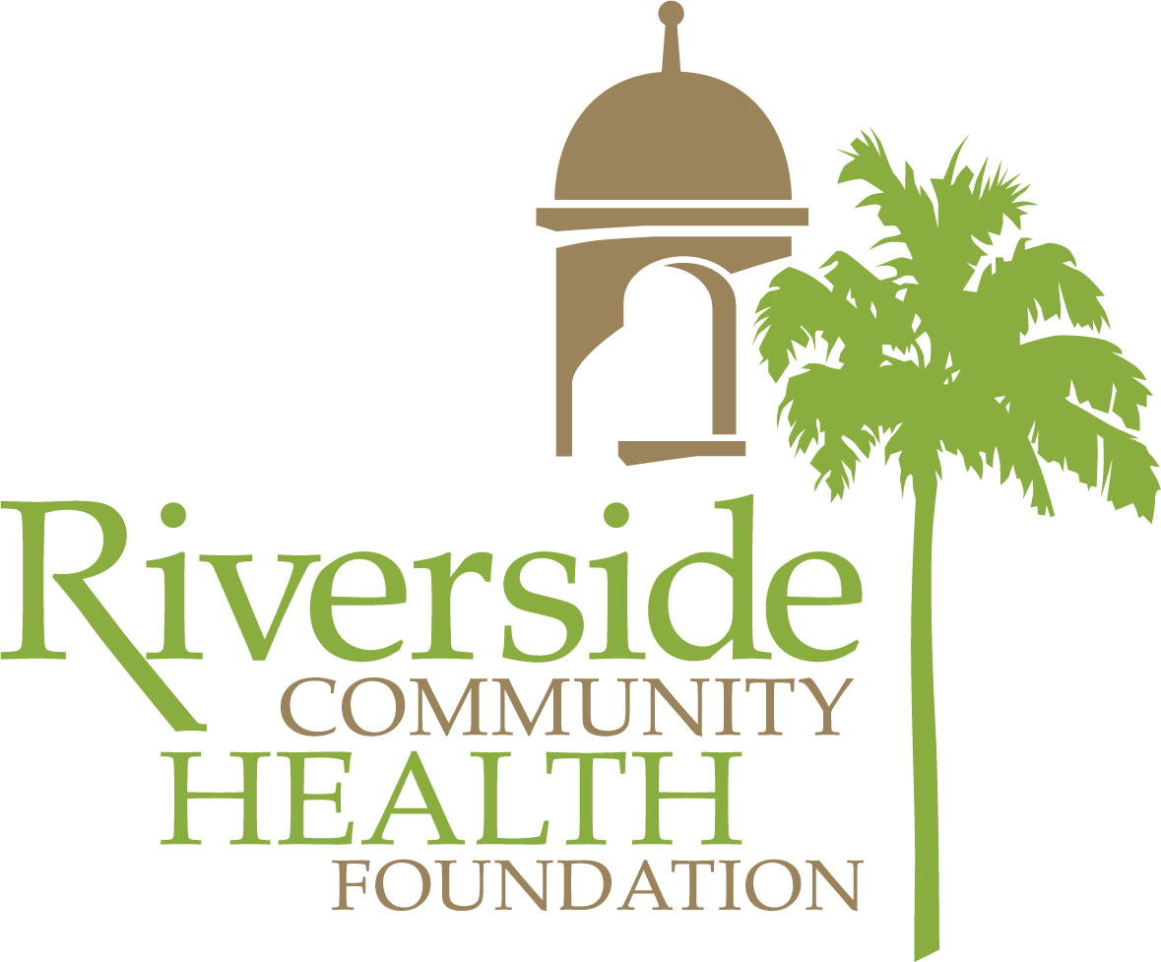

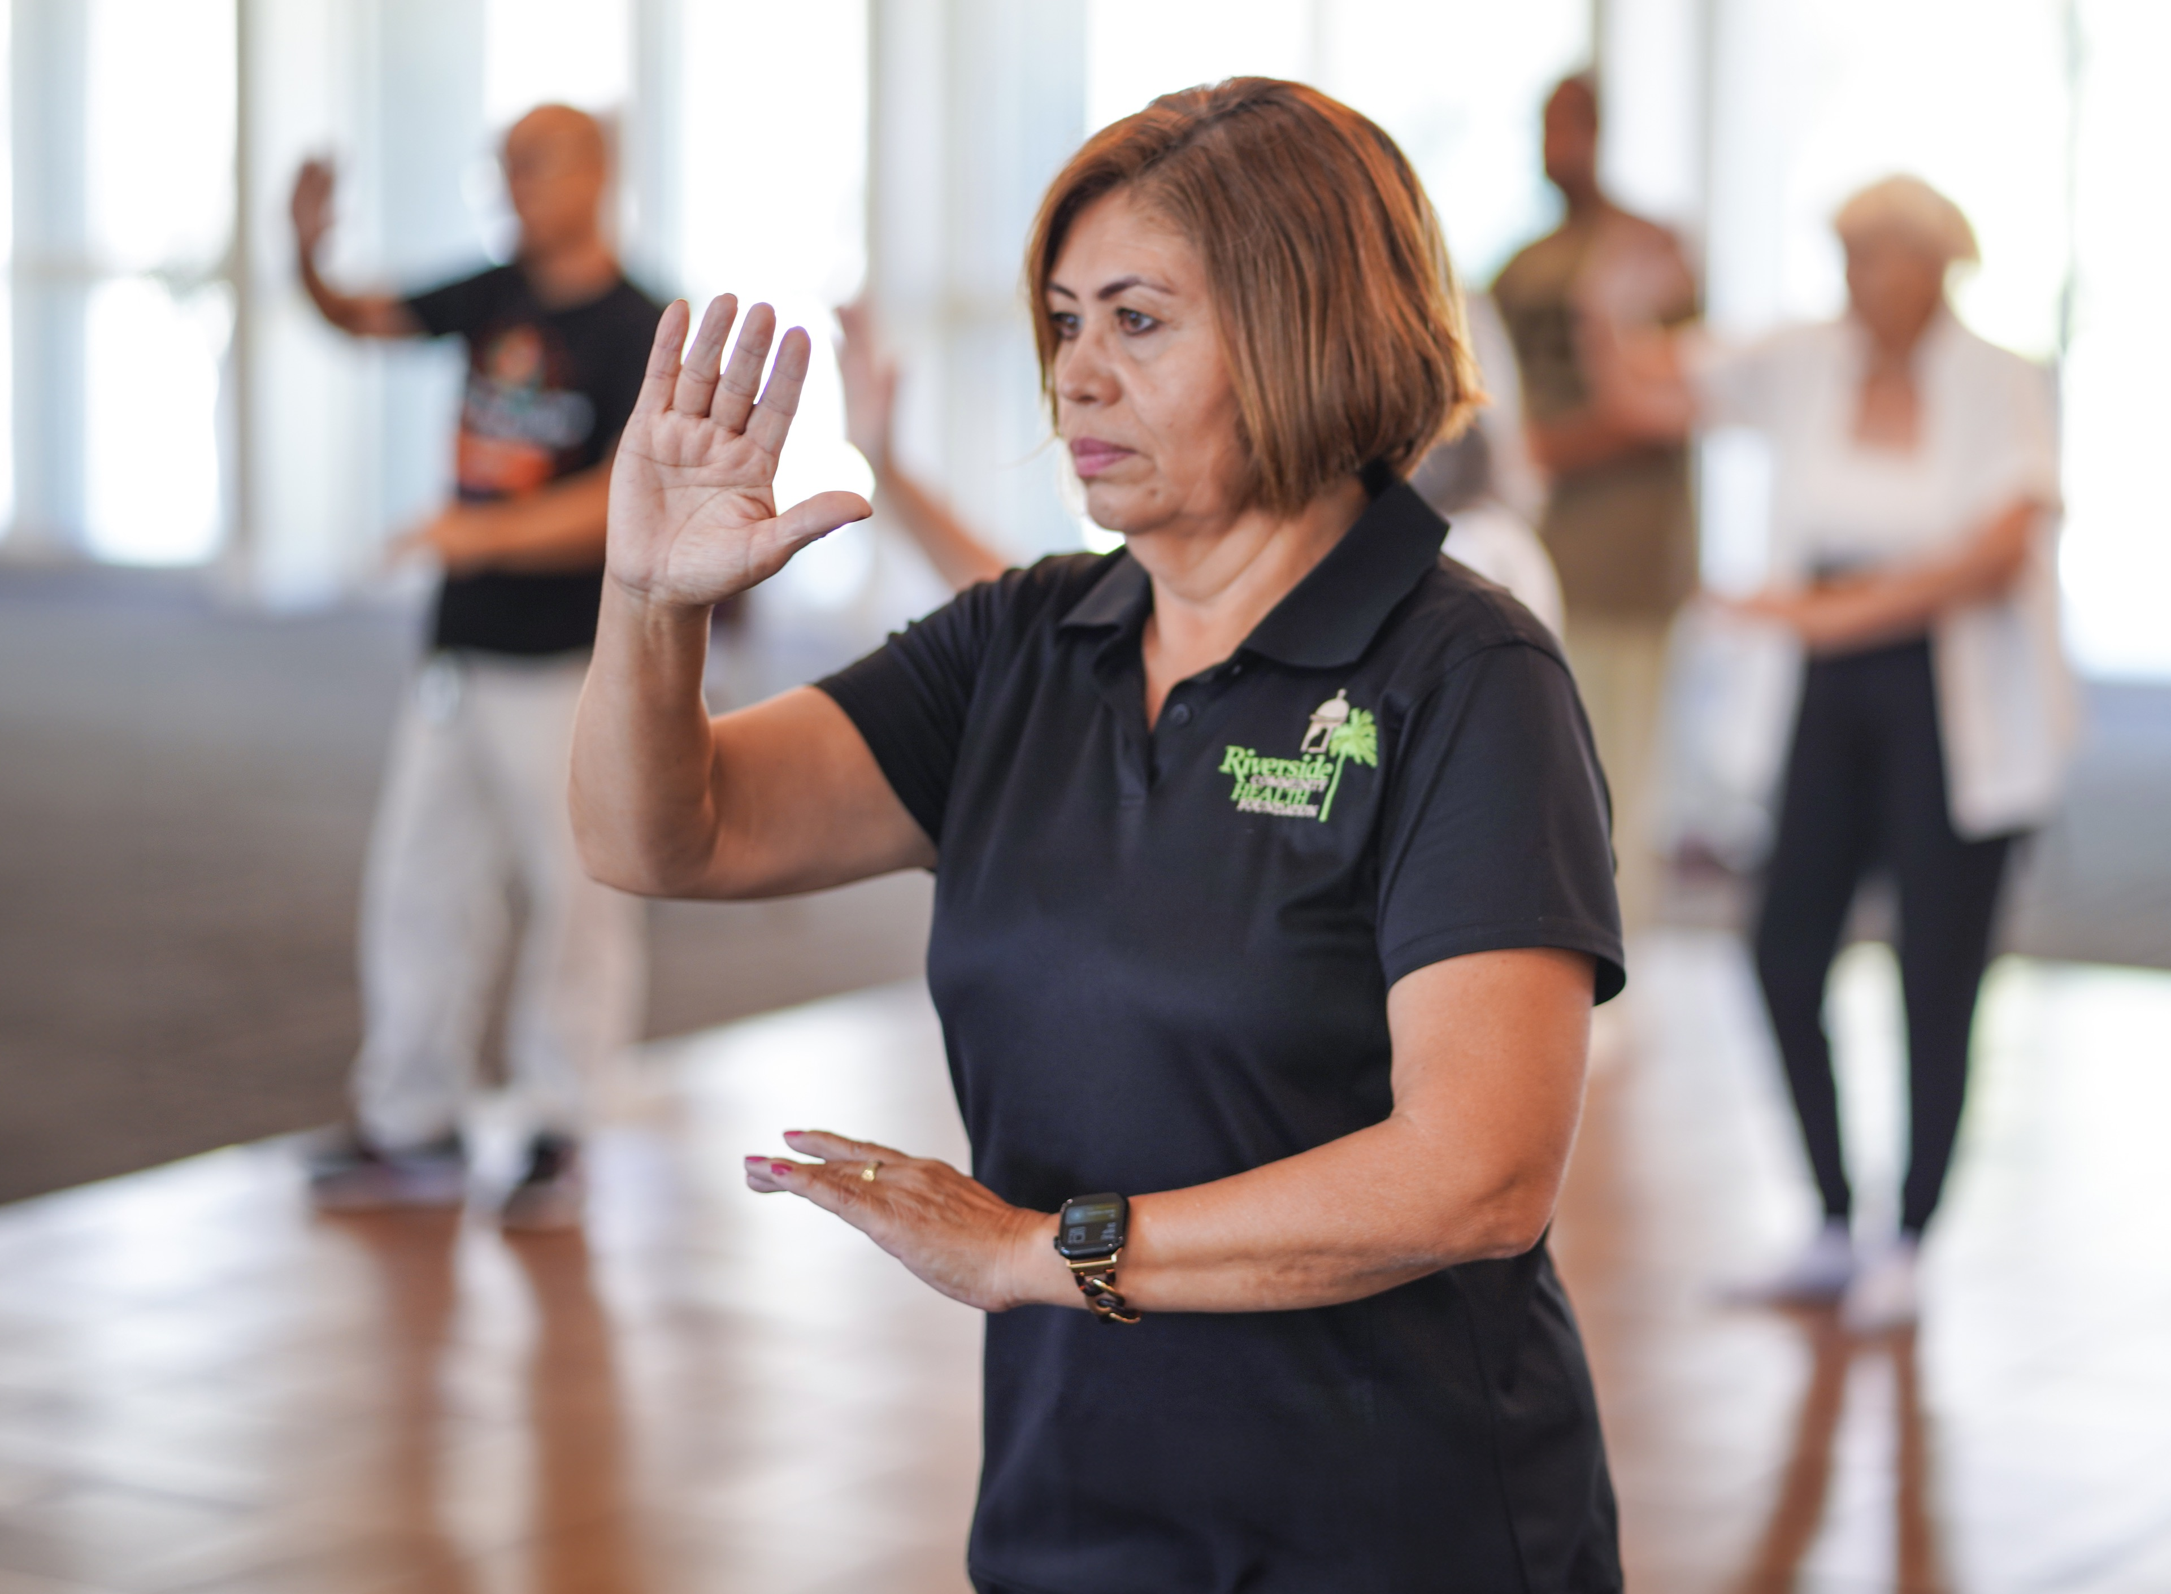
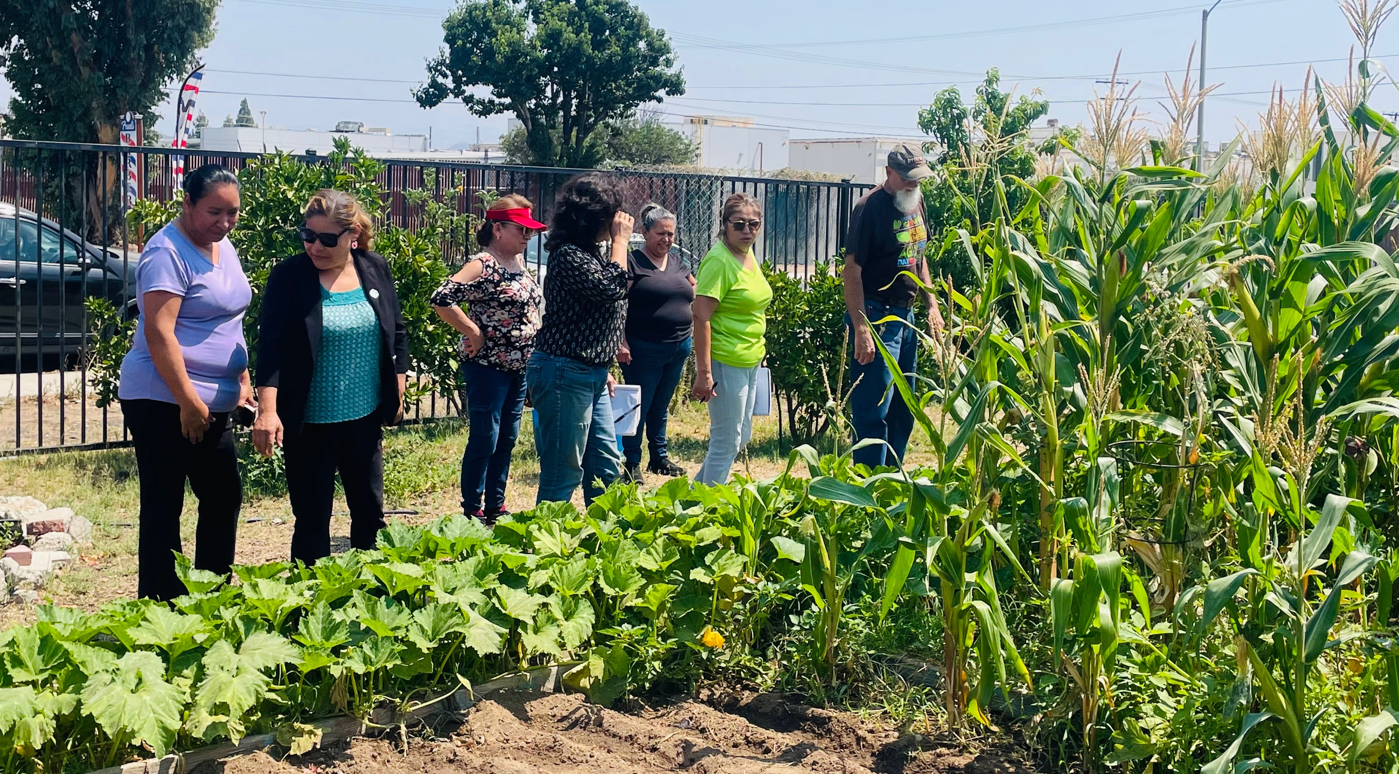
RCHF has been dedicated to improving the health and well-being of our community since 1997.
We deliver a wide variety of programs and services to address health concerns - all at no cost.

Slide 2
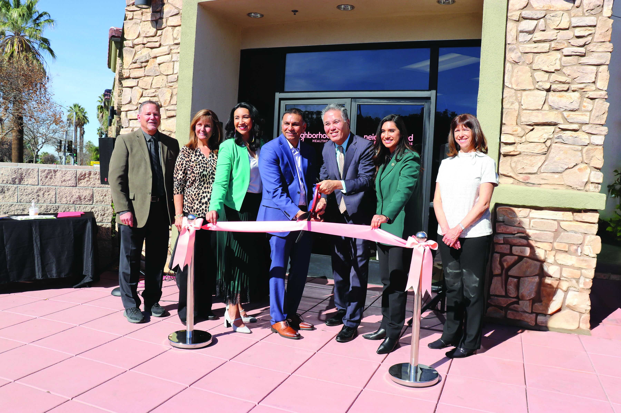

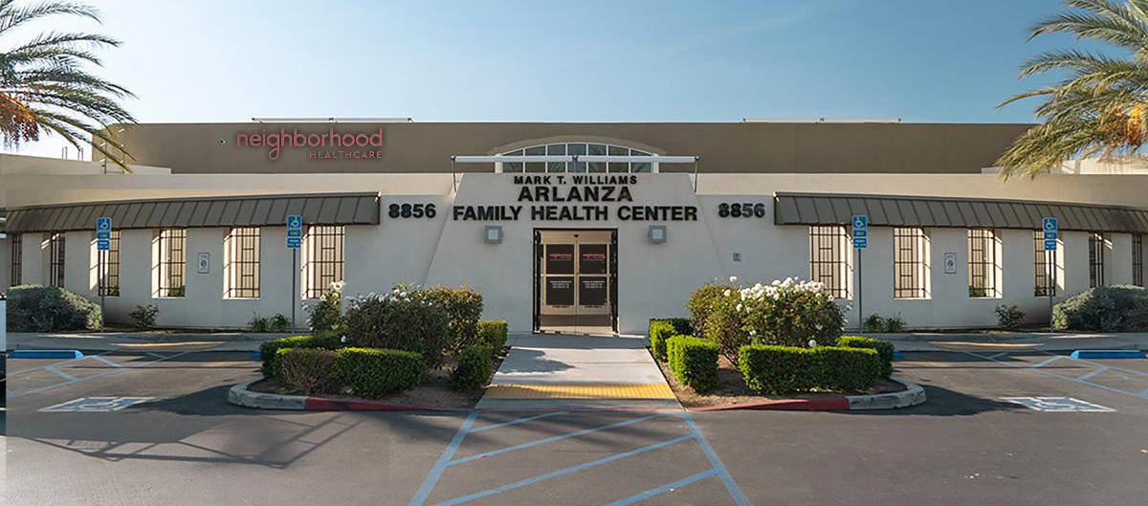
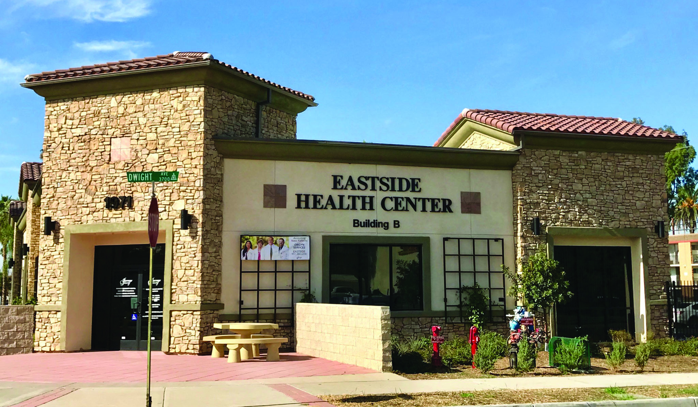
RCHF’s Eastside Health Center A and B,
and the Mark T. Williams Arlanza Family Health Center are operated by Neighborhood Healthcare

